Slide 1
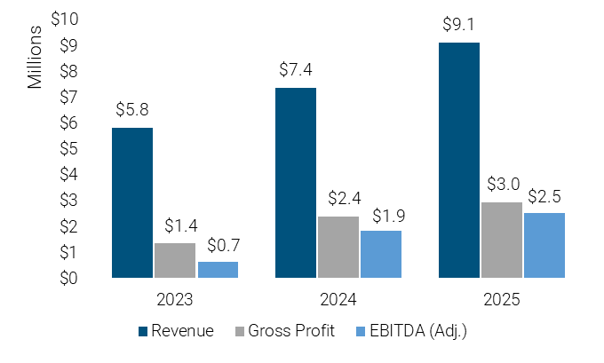
Lancaster | Lewisburg | Sinking Spring | Pittsburgh | York
Confidential Seller Profile
Opportunity #910-1145 – Electronics Manufacturing Services Provider for OEMs
Business Synopsis
Location: U.S. East Coast
Business Structure: S-Corporation
Employees: 31
Years in Business: ≈15
Facility: 25,000 Sq. Ft.,7-acre
campus with expansion capability to 60,000 s.f.
Acquisition Highlights
Strong management team
Primary markets served:
Medical devices
Industrial electronics
Military/Defense
SATCOM
4 surface-mounted technology lines
2 selective solder lines
State-of-the-Art 3D AOI, SPI and CMM
ISO 9001:2015 (world class) and ITAR registered
145,285 circuit boards shipped in 2025
$6 million current backlog
Proprietary quality control process which has delivered a consistent 99.5% return-free rate
40% excess production capacity currently due to Lean improvements
3.5x
99.5%
EBITDA Margin vs. Industry Avg.
On-Time Deliveries
In 2025
Acquisition Summary
Leading provider of end-to-end electronics manufacturing solutions for OEMs (Original Equipment Manufacturers) looking for high-quality, reliable, domestic, and cost-effective solutions for their electronics manufacturing needs: Circuit Card Assemblies (“CCA”), Cable Assembly, and Box Build Assemblies. Lean manufacturing processes and continuous improvement activities have been extensively incorporated throughout all operations. Facilities meet strictest standards to ensure optimal production and quality, including temperature and humidity control, proper ventilation, adherence to safety regulations, and electromagnetic interference.
For Additional Information
Contact Mike Colella at Colella@murphymccormack.com (724.730.4376) or Sandy Miller at smiller@murphymccormack.com (570.524.7253). Upon execution of a confidentiality agreement, qualified parties will be provided with a Confidential Information Memorandum and a Structured Process Letter.
Mergers & Acquisitions
Divestitures
Business Valuations
Business Advisory Services
115 Farley Circle
Suite 308
Lewisburg, PA 17837
murphymccormack.com
570.524.7253

